Slide 1
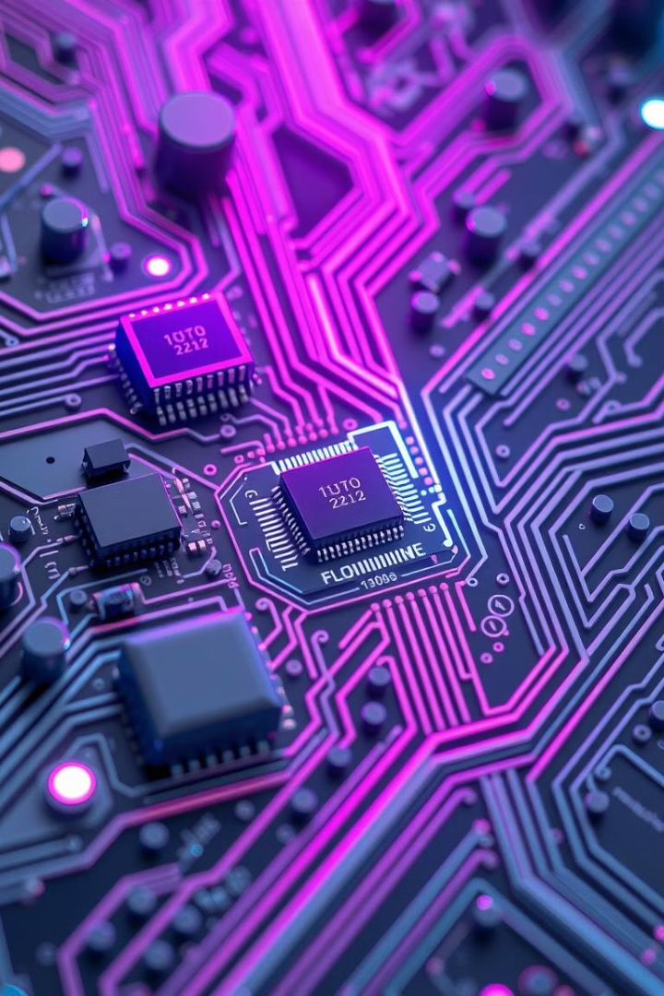
Compiler Optimization for Real-Time IoT Applications
S.NOTOPICSPAGE NO1.Abstract52.Introduction53.Problem Statement64.Proposed Design work65.Functionality6 – 76.Methodology7 – 97.1. Implementation Details2. Results and Analysis3. Challenges and Feature Work9 – 108.Coding10 – 159.Conclusion1510.Bibliography16
EXplore the cutting-edge techniques used to optimize compilers for real-time IoT applications, where performance and efficiency are paramount. Discover how to tackle the unique challenges posed by the resource-constrained nature of IoT devices.
• (P. Naga surendra-192211536)
• (K. Ch. Chandrahas-192211922)

Slide 2
Introduction to IoT and Real-Time Constraints
IoT Landscape
Real-Time Demands
Resource Constraints
The explosive growth of the Internet of Things has revolutionized how we interact with the world around us, from smart homes to industrial automation.
IoT applications often require immediate data processing and decision-making to meet strict latency requirements and ensure responsive, reliable performance.
IoT devices are typically resource-constrained, with limited processing power, memory, and energy, posing unique challenges for compiler optimization.

Slide 3

Challenges in Compiler Optimization for IoT
1
Latency
2
Memory Footprint
Minimizing compilation time is crucial to ensure real-time responsiveness in IoT applications.
Compilers must optimize code size and memory usage to fit within the limited resources of IoT devices.
3
Energy Efficiency
4
Hardware Diversity
Optimizing for power consumption is vital to extend the battery life of IoT devices.
Compilers must adapt to a wide range of IoT hardware configurations and architectures.

Slide 4

Techniques for Reducing Compilation Time
1
Incremental Compilation
Compilers can leverage incremental compilation to minimize the time required to recompile code changes.
2
Parallel Compilation
Utilizing multiple cores or distributed systems to compile code in parallel can significantly speed up the process.
3
Adaptive Optimizations
Compilers can dynamically adjust optimization levels based on the characteristics of the target IoT device.

Slide 5

Memory Optimizations for IoT Devices
Code Size Reduction
Memory Allocation Strategies
Techniques like function inlining, dead code elimination, and data structure packing can minimize the memory footprint of compiled code.
Compilers can employ advanced memory management techniques, such as stack-based allocation and region-based memory management, to optimize memory usage.
Compiler-Assisted Garbage Collection
Hardware-Specific Optimizations
Compilers can integrate with runtime garbage collection systems to efficiently manage dynamic memory allocation and deallocation.
Compilers can leverage the unique memory architectures and features of IoT hardware to further optimize memory usage.

Slide 6
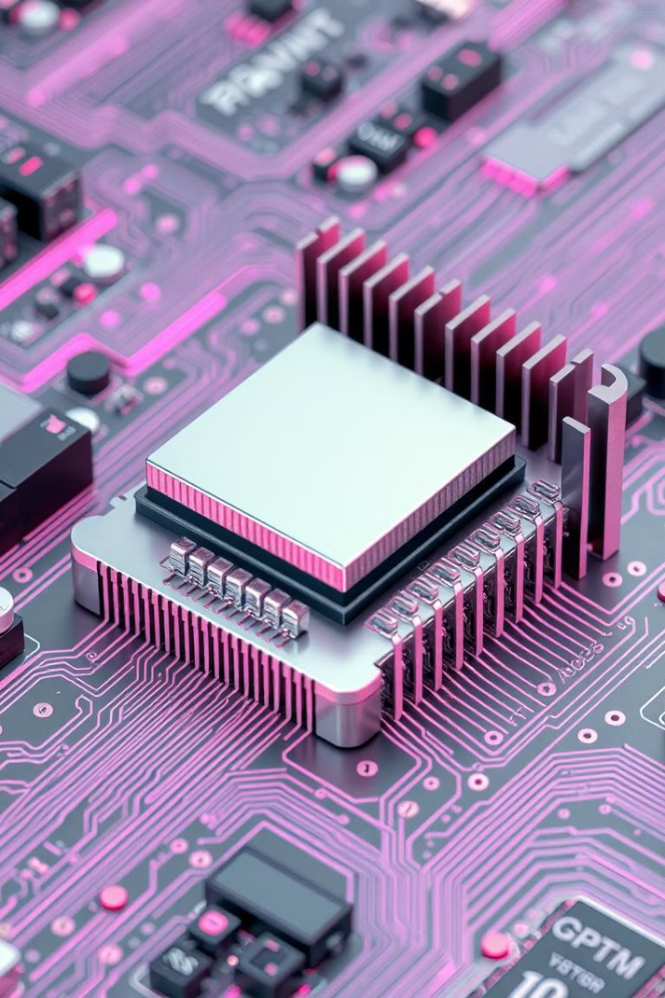



Exploiting Hardware Accelerators
GPU Acceleration
Leveraging the parallel processing power of GPUs can dramatically improve the performance of compute-intensive IoT applications.
FPGA Offloading
Compilers can offload specific tasks to FPGA-based hardware accelerators to enhance efficiency and performance.
AI Acceleration
Integrating AI-powered hardware accelerators can enable advanced real-time analytics and decision-making capabilities for IoT applications.

Slide 7




Adaptive Optimization Strategies
Runtime Profiling
Compilers can collect runtime performance data to dynamically adjust optimization strategies based on the specific needs of the IoT application.
Heuristic-Based Optimization
Intelligent heuristics can guide the compiler's optimization decisions, taking into account the unique characteristics of the target IoT device.
Machine Learning-Driven Optimizations
Leveraging advanced machine learning techniques, compilers can learn and adapt optimization strategies to continuously improve performance and efficiency.

Slide 8

Future Trends and Emerging Technologies
Edge Computing
Bringing computation closer to the data source to reduce latency and improve real-time responsiveness.
5G and 6G Networks
Enabling ultra-low latency and high-bandwidth communication for IoT applications.
Quantum Computing
The potential for quantum-powered compilers to revolutionize optimization techniques for IoT devices.
Neuromorphic Computing
Developing specialized hardware architectures inspired by the human brain to enhance AI-powered IoT applications.

Slide 9
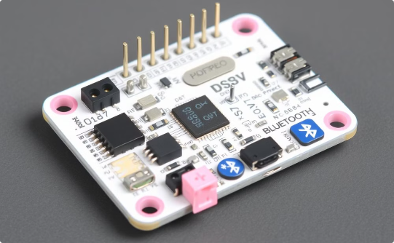

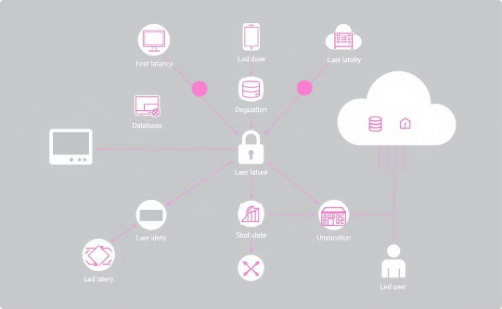
Optimization for IoT Applications
Hardware Optimization
Software Optimization
Network Optimization
Compilers can tailor code to the specific hardware constraints of IoT devices, such as limited processing power, memory, and energy consumption.
Compiler optimizations can reduce code size, improve execution speed, and enhance the overall efficiency of IoT software applications.
Compilers can optimize network communication protocols and data formats to minimize latency and bandwidth usage for IoT systems.

Slide 10

Conclusion
As we've explored, compiler optimization plays a vital role in enabling real-time performance and efficiency for IoT applications. From exploiting hardware accelerators to leveraging adaptive optimization strategies, the future of IoT optimization holds exciting possibilitiThan

Slide 11
Thank You

